Slide 1
Online Banking
Presented by:
Nihitha Mahadas
(51897511)

Slide 2
Contents
Introduction
Scope
Technology Used
Outputs

Slide 3
Introduction
Online banking, also known as internet banking or web banking, is an electronic payment system that enables customers of a bank or other financial institution to conduct a range of financial transactions through the financial institution's website.
Online banking offers customers almost every service traditionally available through a local branch including deposits, transfers, and online bill payments.
Virtually every banking institution has some form of online banking, available both on desktop versions and through mobile apps.

Slide 4
Scope
Actions:
Login:
AddUser
Deposit:
Withdraw
Fund Transfer
AddAccount
ShowAllAccounts
ShowAllUsers
UpdateAccount/UpdateUser

Slide 5
Validations:
Account number
Withdraw
Fund Transfer
Updating User/Account:
While updating user/account only specific data can be updated. The data are Address,
Phone and Email.
Aadhar card and Pan card cannot be updated for an user/account.
The type of user can also be changed by the admin.

Slide 6
Technology used
Java
Html,CSS
JSP
MySQL
Javascript
Hibernet
Spring

Slide 7
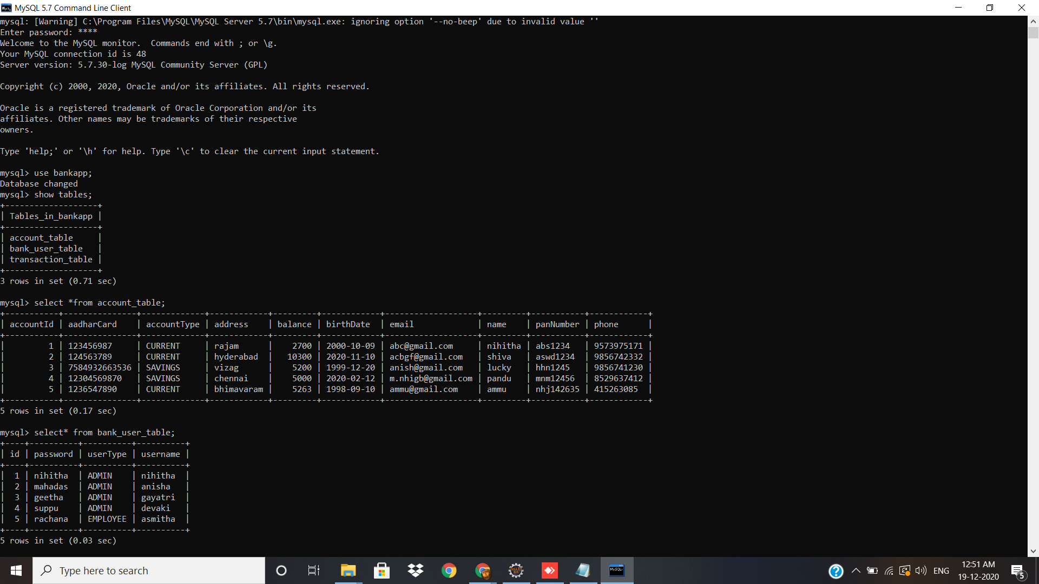
Outputs:

Slide 8
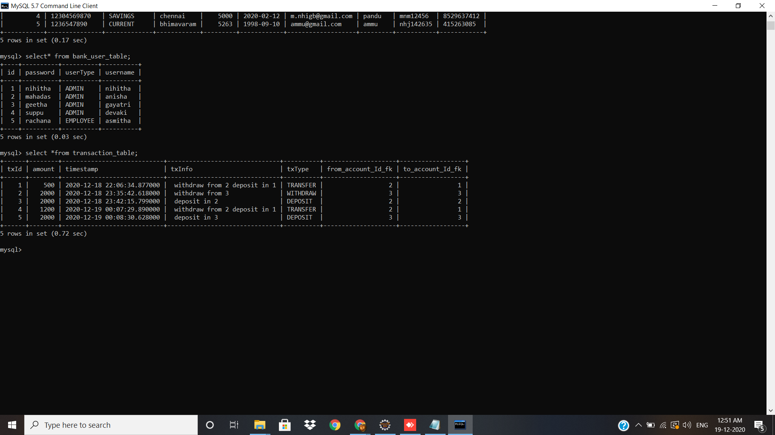

Slide 9
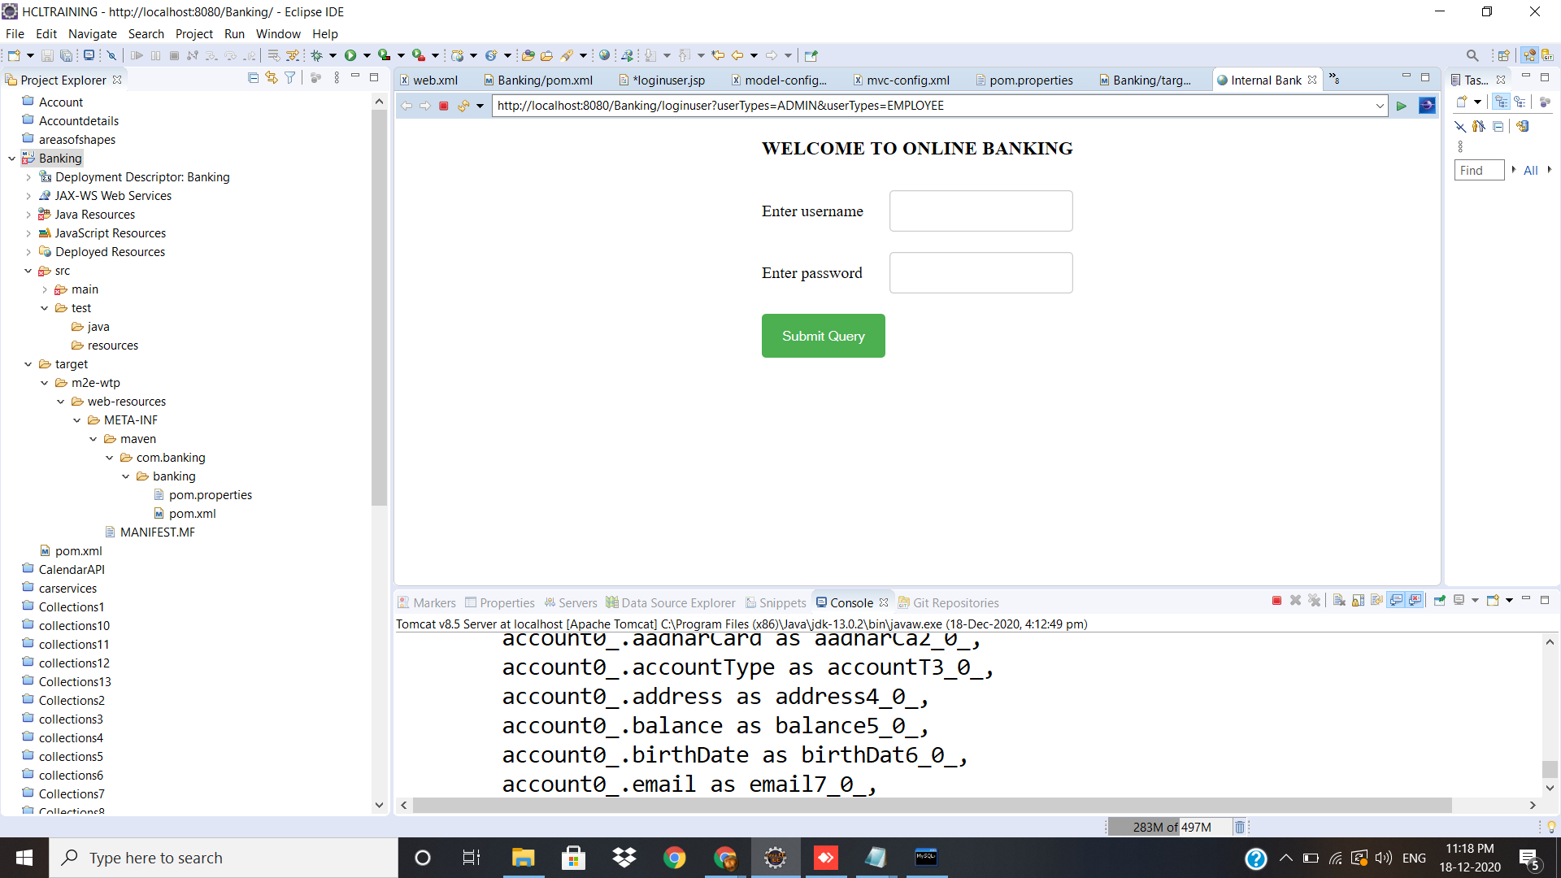
Online Banking Homepage

Slide 10
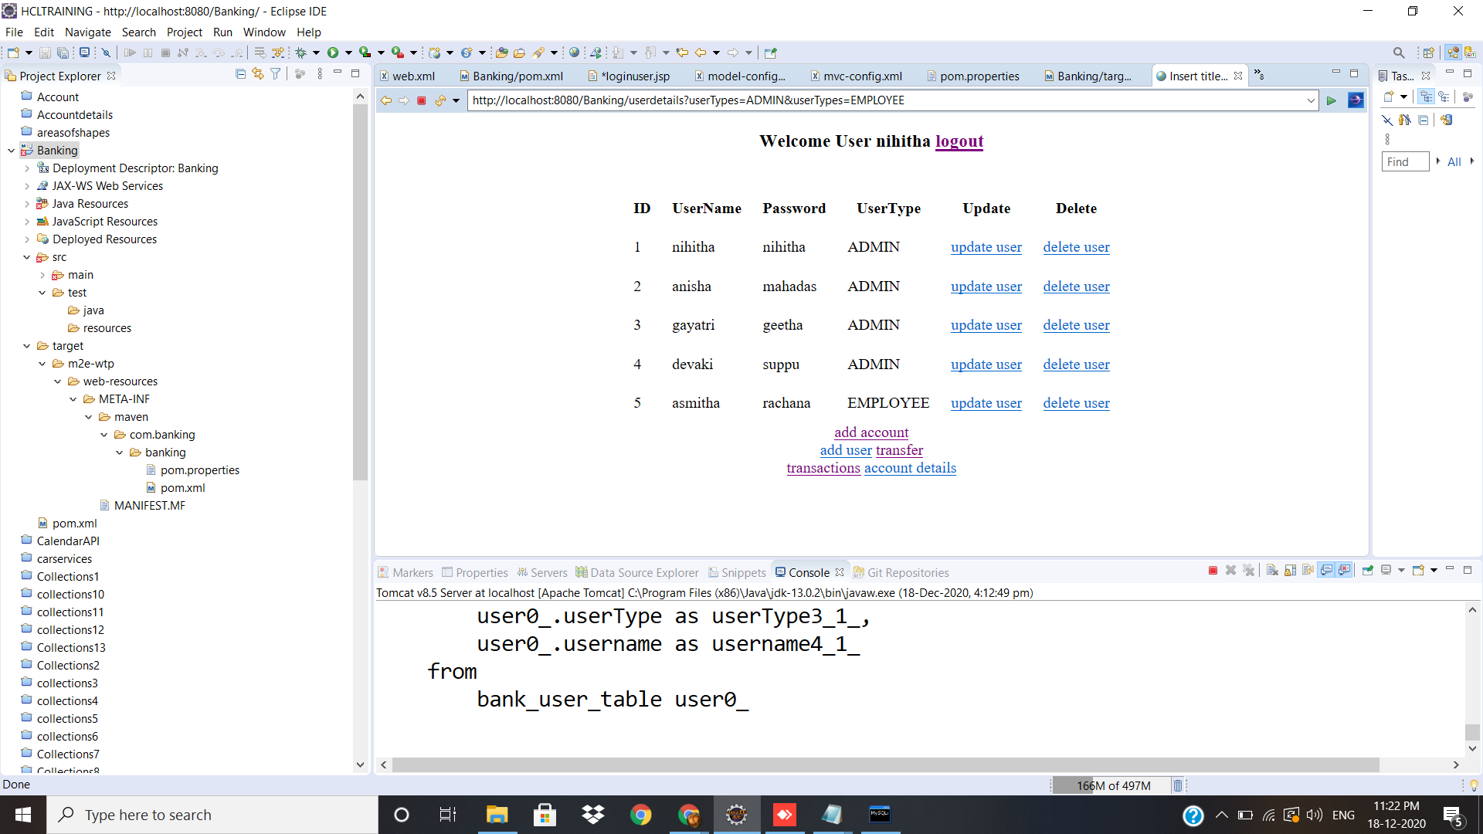

Slide 11
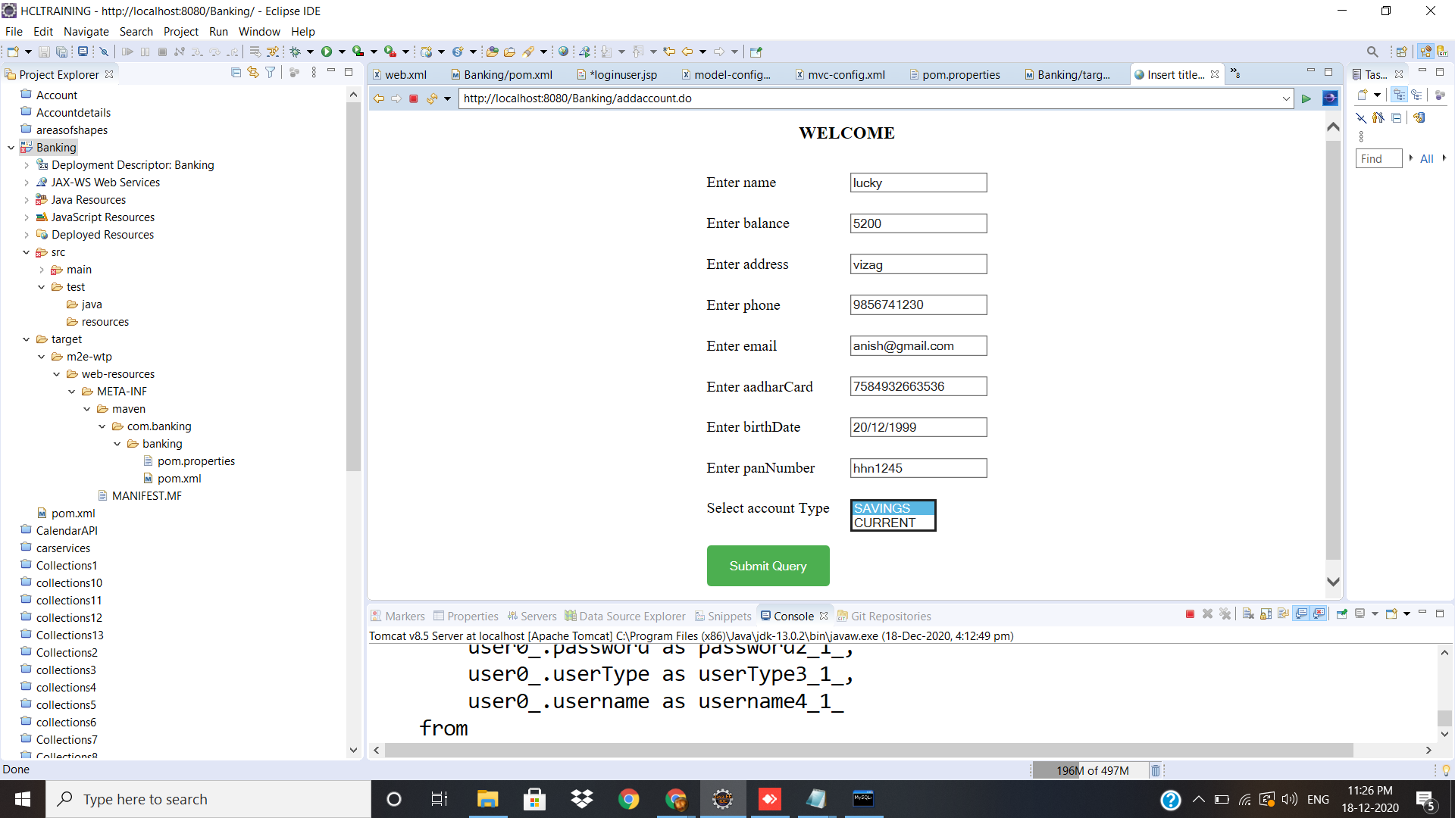

Slide 12
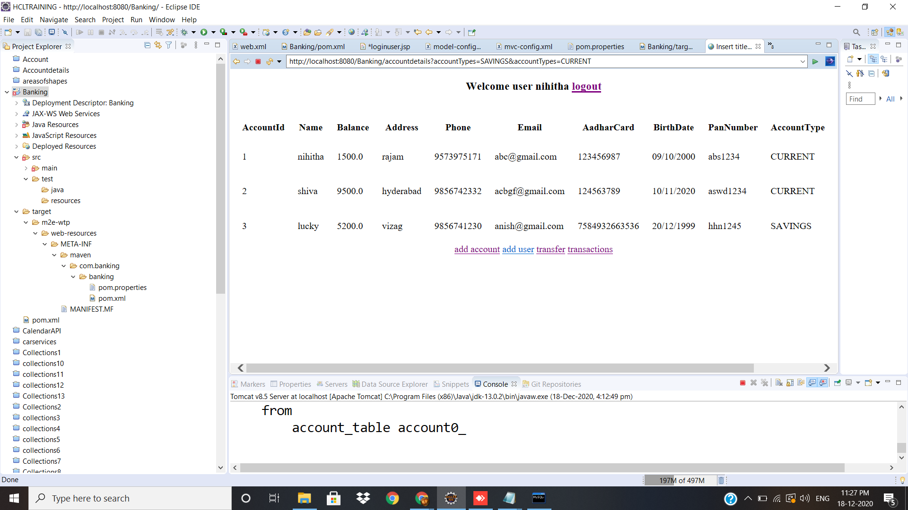

Slide 13
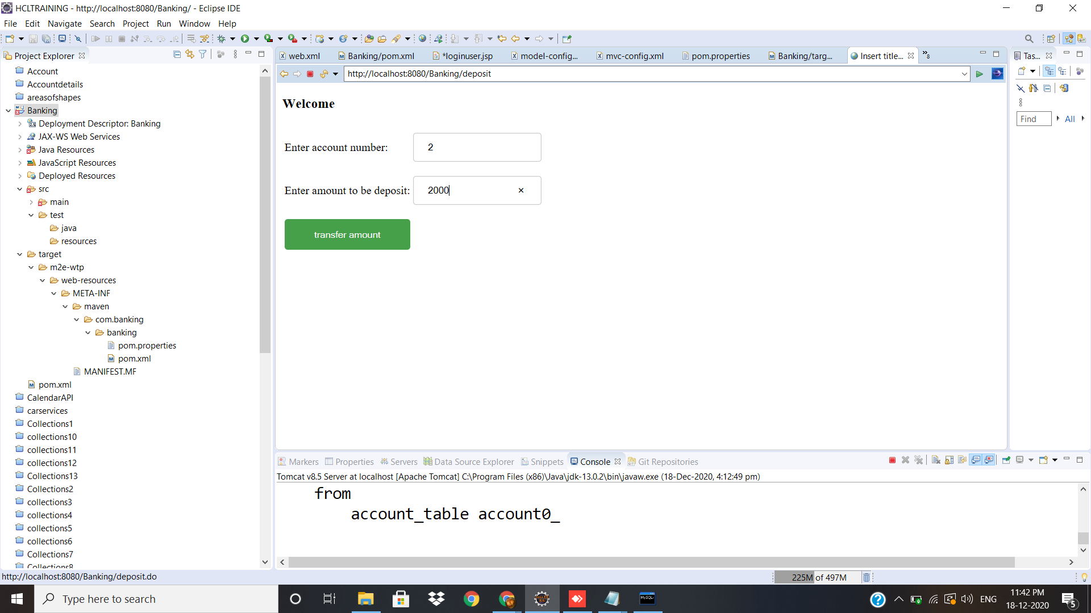

Slide 14


Slide 15


Slide 16
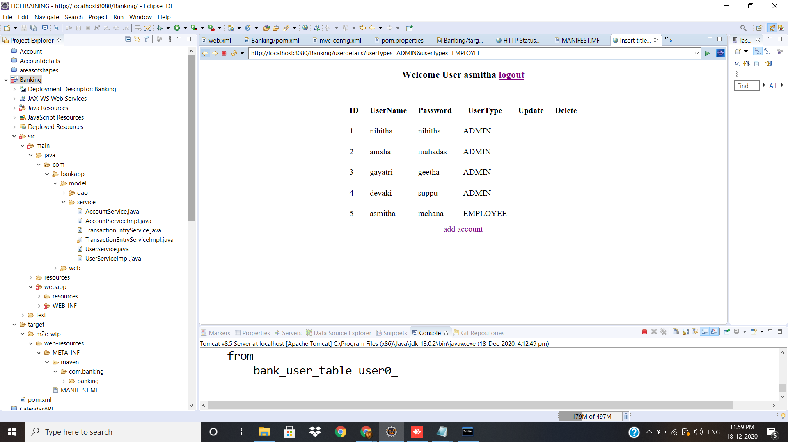

Slide 17
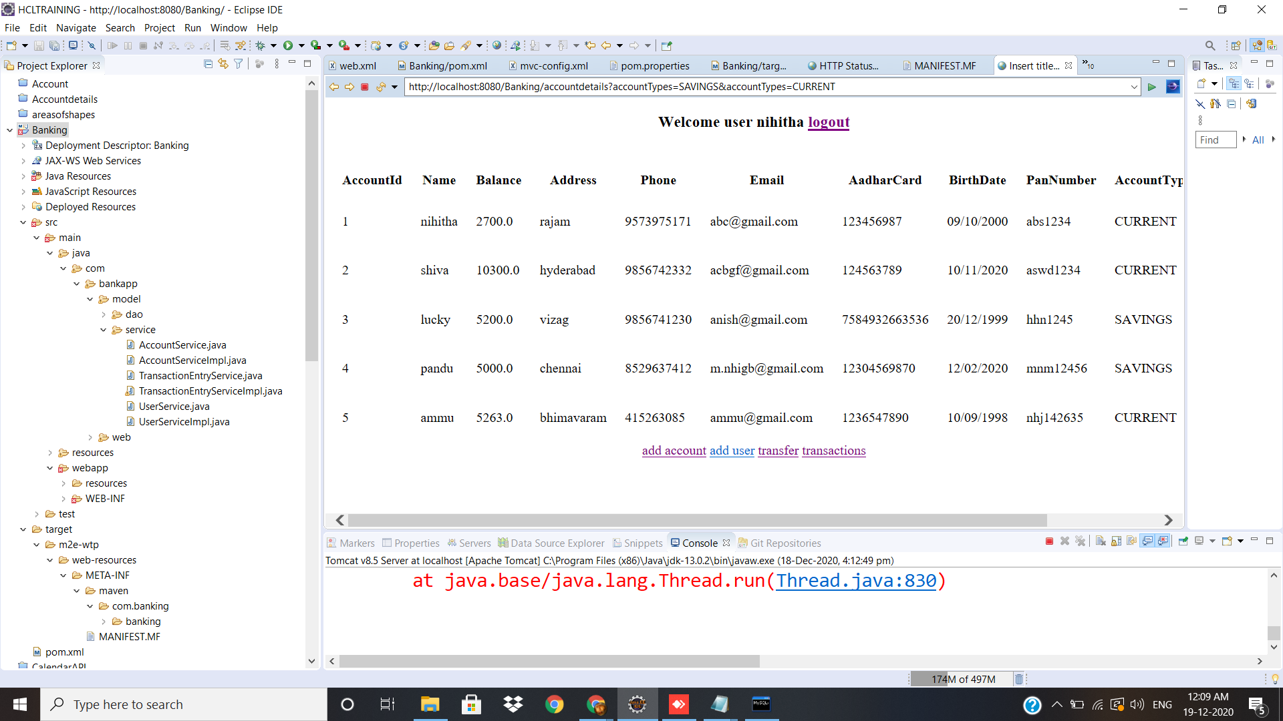

Slide 18


